Slide 1
10% Rule Logic
3 various of the 10% rule were evaluated
10% rule applied to opening value
10% rule applied to the opening value with buying and selling based on intra day high and lows
10% rule applied to the intra day high and lows

Slide 2
Understanding the Data
The data downloaded consists of the date, opening value, day high, day low, close value, volume, and adjusted close value.
Date | Open | High | Low | Close | Volume | Adj Close
1/3/2007 | 16.04 | 16.04 | 14.96 | 15.21 | 381600 | 5.07

Slide 3
Understanding the Data
The adjusted close value gives the closing price of the stock when adjusted for dividends, stock splits, stock buybacks, and other non-market changes to the stock price. The adjusted close decreases the historic price of a stock so that the current stock price is accurate and reflects the real returns a stock that was purchased at that time would have.
Date | Open | High | Low | Close | Volume | Adj Close
1/3/2007 | 16.04 | 16.04 | 14.96 | 15.21 | 381600 | 5.07

Slide 4
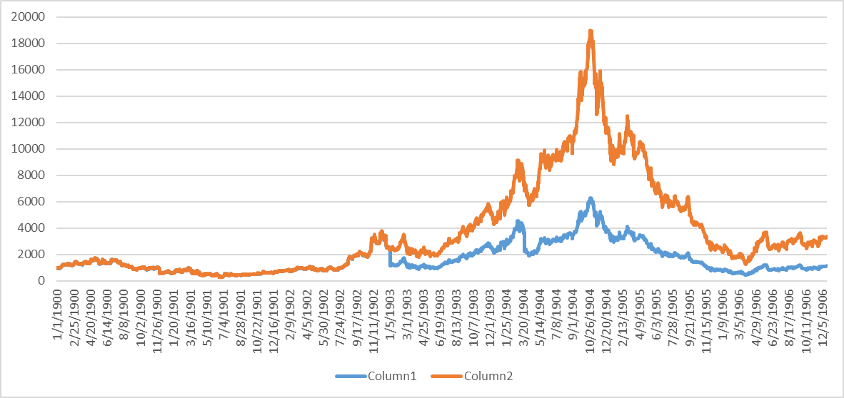
Understanding the Data
The graph below shows $1000 invested into the same stock. The blue line shows the return based on the close price. The orange line shows the return based on the adjusted price.

Slide 5

Understanding the Data
Using the adjusted close, the adjusted open, high, and low are calculated. This assumption is made to allow the 10% rule to be used effectively. This assumption will need some validation to build confidence in the data.
$$Adjusted Open=Adjusted Multiple ×Open$$
$$Adjusted Multiple=\frac{Adj Close}{Close}$$
$$Adjusted High=Adjusted Multiple ×High$$
$$Adjusted High=Adjusted Multiple ×Low$$
Date | Open | High | Low | Close | Volume | Adj Close | Adj Open | Adj High | Adj Low
1/3/2007 | 16.04 | 16.04 | 14.96 | 15.21 | 381600.00 | 5.07 | 5.35 | 5.35 | 4.99
1/4/2007 | 15.21 | 15.21 | 14.38 | 14.78 | 394800.00 | 4.93 | 5.07 | 5.07 | 4.79

Slide 6
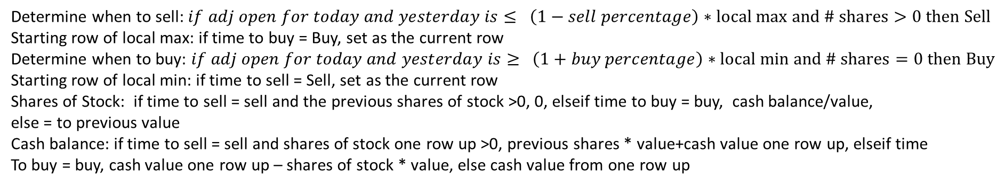
10% Rule Applied to Opening Value
The following calculations are applied based on the adjusted opening values of a stock.
Determines when to sell
Determines when to buy
Shares of stock
Total value of stock and cash
Adj Open Value
Gives starting row number of the local max
Gives starting row number of the local min
Cash from sale and for buying
Value for buy and hold
Date | Value | Time to Sell | Local Max Starting Row | Time to Buy | Local Min Starting Row | # Shares | Cash Balance | Total Value | Buy and Hold
1/3/2007 | 5.347 |  | 22 |  | 22 | 100 | 0 | 534.7 | 534.7
1/4/2007 | 5.07 |  | 22 |  | 22 | 100 | 0 | 507.0 | 507.0
1/5/2007 | 4.893 |  | 22 |  | 22 | 100 | 0 | 489.3 | 489.3
1/8/2007 | 4.81 | Sell | 22 |  | 25 | 0 | 481 | 481.0 | 481.0
Determine when to sell: $if adj open for today and yesterday is≤ \left(1−sell percentage\right)∗local max and \# shares>0 then Sell$
Starting row of local max: if time to buy = Buy, set as the current row
Determine when to buy: $if adj open for today and yesterday is≥ \left(1+buy percentage\right)∗local min and \# shares=0 then Buy$
Starting row of local min: if time to sell = Sell, set as the current row
Shares of Stock: if time to sell = sell and the previous shares of stock >0, 0, elseif time to buy = buy, cash balance/value,
else = to previous value
Cash balance: if time to sell = sell and shares of stock one row up >0, previous shares * value+cash value one row up, elseif time
To buy = buy, cash value one row up – shares of stock * value, else cash value from one row up

Slide 7
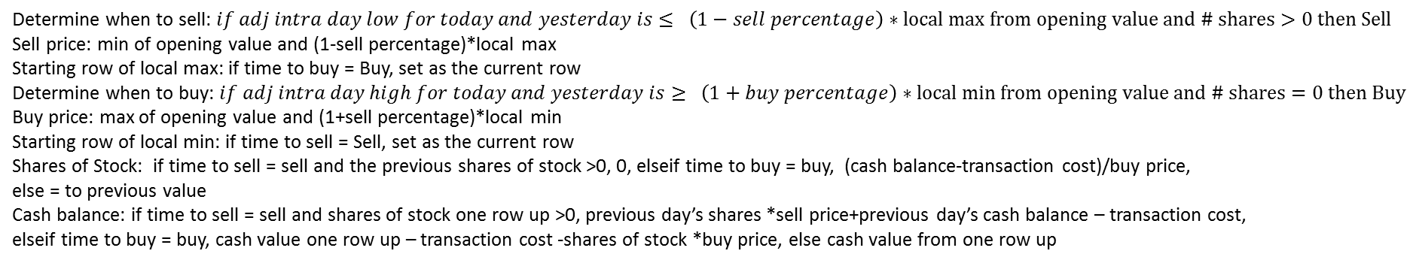
10% Rule Applied to Opening Value and Intra day prices
The following calculations are applied based on the adjusted opening values of a stock.
Adj Intra Day High
Determines when to sell
Gives starting row number of the local max
Price to Buy At
Cash Balance
Shares of stock
Determines when to buy
Total value of stock and cash
Adj Open
Adj Intra Day Low
Price to Sell At
Gives starting row number of the local min
Transaction Cost
Date | Open | High | Low | Time to Sell | Sell Price | Local Max Starting Row | Time to Buy | Buy Price | Local Min Starting Row | # Shares | Transaction Cost | Cash Balance | Total Value | Buy and Hold
1/3/2007 | 5.35 | 5.35 | 4.99 |  |  | 22.00 |  |  | 22.00 | 187.00 |  | 0.00 | 999.83 | 999.83
1/4/2007 | 5.07 | 5.07 | 4.79 |  | 4.81 | 22.00 |  | 5.58 | 22.00 | 187.00 |  | 0.00 | 948.09 | 948.09
1/5/2007 | 4.89 | 4.90 | 4.83 |  | 4.81 | 22.00 |  | 5.38 | 22.00 | 187.00 |  | 0.00 | 915.05 | 915.05
1/8/2007 | 4.81 | 4.86 | 4.77 |  | 4.81 | 22.00 |  | 5.29 | 22.00 | 187.00 |  | 0.00 | 899.47 | 899.47
1/9/2007 | 4.82 | 4.89 | 4.76 | Sell | 4.81 | 22.00 |  | 5.29 | 26.00 | 0.00 | 0.00 | 899.84 | 899.84 | 900.72
Determine when to sell: $if adj intra day low for today and yesterday is≤ \left(1−sell percentage\right)∗local max from opening value and \# shares>0 then Sell$
Sell price: min of opening value and (1-sell percentage)*local max
Starting row of local max: if time to buy = Buy, set as the current row
Determine when to buy: $if adj intra day high for today and yesterday is≥ \left(1+buy percentage\right)∗local min from opening value and \# shares=0 then Buy$
Buy price: max of opening value and (1+sell percentage)*local min
Starting row of local min: if time to sell = Sell, set as the current row
Shares of Stock: if time to sell = sell and the previous shares of stock >0, 0, elseif time to buy = buy, (cash balance-transaction cost)/buy price,
else = to previous value
Cash balance: if time to sell = sell and shares of stock one row up >0, previous day’s shares *sell price+previous day’s cash balance – transaction cost,
elseif time to buy = buy, cash value one row up – transaction cost -shares of stock *buy price, else cash value from one row up

Slide 8
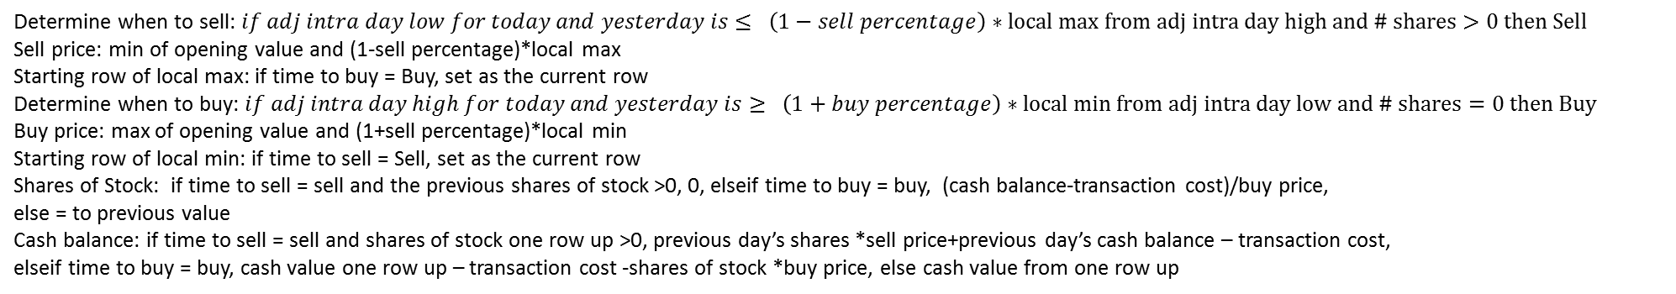
10% Rule Applied to Intra day prices
The following calculations are applied based on the intra day prices of a stock
Adj Intra Day High
Determines when to sell
Gives starting row number of the local max
Price to Buy At
Cash Balance
Value for buy and hold
Shares of stock
Determines when to buy
Total value of stock and cash
Adj Open
Adj Intra Day Low
Price to Sell At
Gives starting row number of the local min
Transaction Cost
Date | Open | High | Low | Time to Sell | Sell Price | Local Max Starting Row | Time to Buy | Buy Price | Local Min Starting Row | # Shares | Transaction Cost | Cash Balance | Total Value | Buy and Hold
1/3/2007 | 5.35 | 5.35 | 4.99 |  |  | 22.00 |  |  | 22.00 | 187.00 |  | 0.00 | 999.83 | 999.83
1/4/2007 | 5.07 | 5.07 | 4.79 |  | 4.81 | 22.00 |  | 5.58 | 22.00 | 187.00 |  | 0.00 | 948.09 | 948.09
1/5/2007 | 4.89 | 4.90 | 4.83 |  | 4.81 | 22.00 |  | 5.38 | 22.00 | 187.00 |  | 0.00 | 915.05 | 915.05
1/8/2007 | 4.81 | 4.86 | 4.77 |  | 4.81 | 22.00 |  | 5.29 | 22.00 | 187.00 |  | 0.00 | 899.47 | 899.47
1/9/2007 | 4.82 | 4.89 | 4.76 | Sell | 4.81 | 22.00 |  | 5.29 | 26.00 | 0.00 | 0.00 | 899.84 | 899.84 | 900.72
Determine when to sell: $if adj intra day low for today and yesterday is≤ \left(1−sell percentage\right)∗local max from adj intra day high and \# shares>0 then Sell$
Sell price: min of opening value and (1-sell percentage)*local max
Starting row of local max: if time to buy = Buy, set as the current row
Determine when to buy: $if adj intra day high for today and yesterday is≥ \left(1+buy percentage\right)∗local min from adj intra day low and \# shares=0 then Buy$
Buy price: max of opening value and (1+sell percentage)*local min
Starting row of local min: if time to sell = Sell, set as the current row
Shares of Stock: if time to sell = sell and the previous shares of stock >0, 0, elseif time to buy = buy, (cash balance-transaction cost)/buy price,
else = to previous value
Cash balance: if time to sell = sell and shares of stock one row up >0, previous day’s shares *sell price+previous day’s cash balance – transaction cost,
elseif time to buy = buy, cash value one row up – transaction cost -shares of stock *buy price, else cash value from one row up

Slide 9
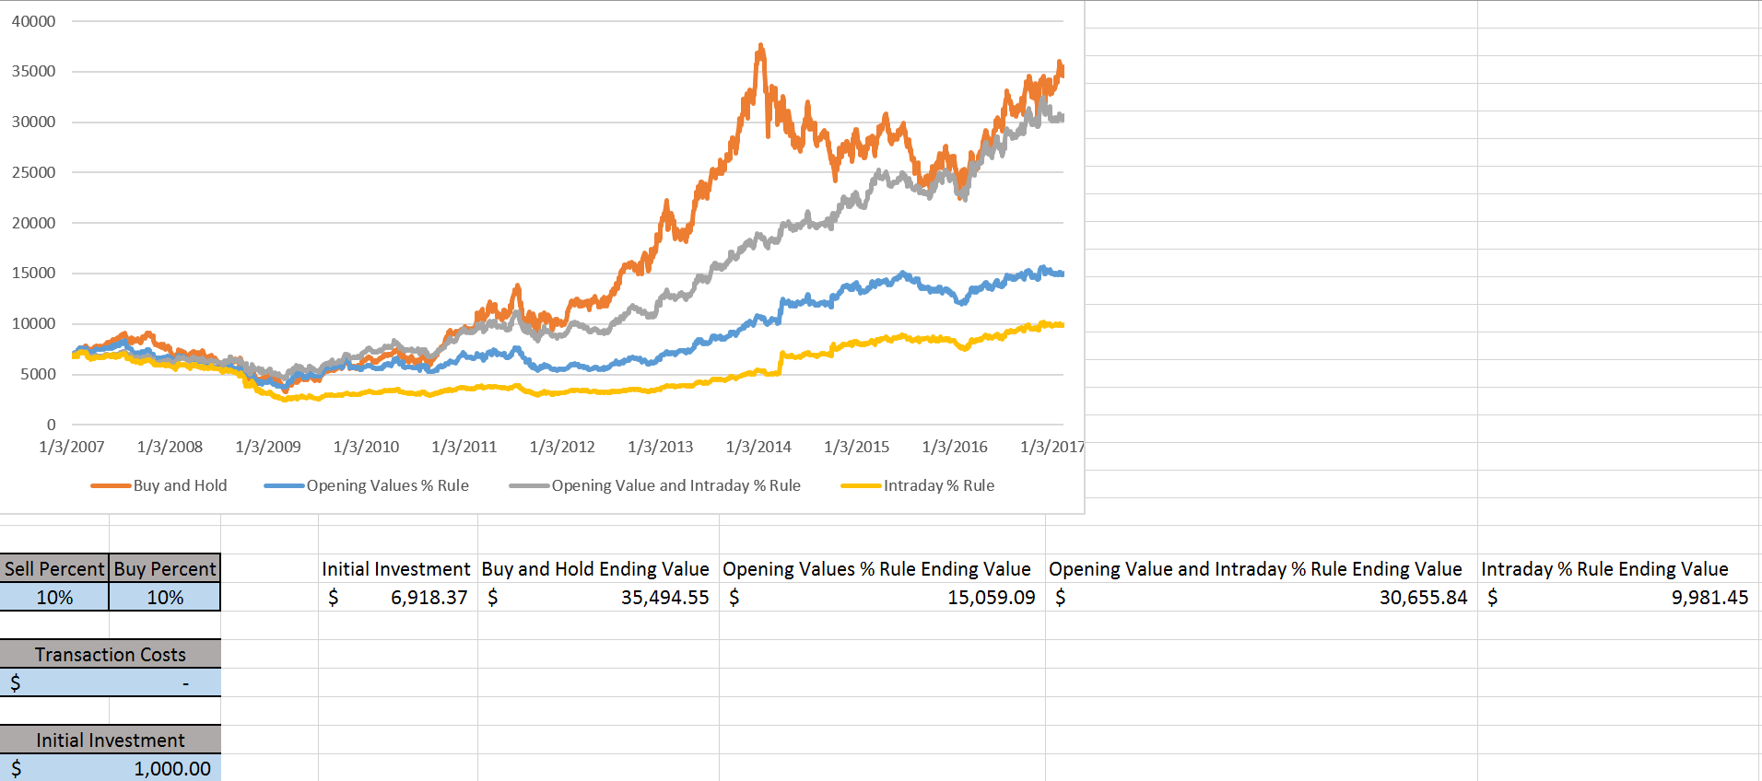
Results
The following results are from the three different applications of the rule.
From the results the opening values with intraday high and lows should be used

